Slide 1
Ideal customer profile (ICP) worksheet for B2B teams
Our B2B SaaS services: SEO Audits | Enterprise SEO Programs | Web Builds | Web Support | We work with: Tech Startups | CMOs | Demand Gen Leaders

Slide 2
By completing this sheet, you should have a clear picture of who your ICP is, how to validate your ideal profile and apply your findings to your B2B strategy.
Use this worksheet to:
Make your own copy of it
Rename it to reflect your company name
Fill out each section to have actionable data for your B2B strategy
💡 Our CMO community requested this complementary resource after reading a popular article we released on ICP. Read the post here: https://productiveshop.com/ideal-customer-profile/

Slide 3
What is an ideal customer profile (ICP)?
Also known as an ideal buyer profile, an ideal customer profile is a hypothetical description of the type of person who is most likely to benefit from your product or service and become a loyal and profitable customer.
An ICP is a crucial strategic document that guides business downstream efforts by helping you identify your target audience's key characteristics, needs, behaviors and preferences.
An ICP is not a buyer persona…
An ICP gives a high-level overview of accounts (companies) your sales teams should target while a buyer persona is more specific as it doubles down on individuals within those companies.
An ICP highlights characteristics of the company and its tech stack while a buyer persona focuses on motivations, pain points, information sources and KPIs of teams within these companies.
Our B2B SaaS services: SEO Audits | Enterprise SEO Programs | Web Builds | Web Support | We work with: Tech Startups | CMOs | Demand Gen Leaders

Slide 4
Brief example of an ICP
Here’s a redacted sample of an ICP for Productive Shop, a B2B SaaS marketing consultancy:
Our B2B SaaS services: SEO Audits | Enterprise SEO Programs | Web Builds | Web Support | We work with: Tech Startups | CMOs | Demand Gen Leaders

Slide 5
Why you need an ICP in your B2B strategy
An accurate ICP provides your organization with these benefits:
Targeted marketing. By identifying your ideal customer, you can create targeted marketing campaigns that are more likely to resonate with them. This approach allows you to focus your marketing efforts on the customers who are most likely to buy from you, improving the effectiveness of your campaigns and reducing wasted marketing spend.
A good example of targeted marketing is the use of personalized emails based on segments created in your email service provider. HubSpot's ultimate list of marketing statistics in 2022 reveals that personalized emails can improve click-through rates by 14%, increase conversions by 10% and generate 18 times more traffic than usual. With an ICP, you can create the right segments and put the right prospects within them.
Sales strategies. Understanding your ideal customer's needs and preferences can help you tailor your sales strategies to appeal to them. With custom sales strategies, which inform how your sales team positions products to customers, you close more deals, improve your conversion rates and create a more fluid sales process. This approach increases your organization's revenue and keeps your sales pipeline filled.
Our B2B SaaS services: SEO Audits | Enterprise SEO Programs | Web Builds | Web Support | We work with: Tech Startups | CMOs | Demand Gen Leaders

Slide 6
Why you need an ICP in your B2B strategy (cont’d)
Product development. Knowing your ideal customer can help you develop products and services that are better suited to their needs and preferences. An ICP helps your team lay out a future product roadmap with updates and changes. This capability can help you improve customer satisfaction, build loyalty and increase customer lifetime value (CLV).
For example, if your ICP revolves around SaaS startups, you can create plans to expand your product offerings, which allows you to scale with your existing customers when they grow and still cater to upcoming startups.
Customer retention. Per Gartner, only about 15% of client interactions provide value enhancement, which involves increasing the relative value and profitability of an organization while mitigating risks. By understanding your ideal customer, you can provide value in every interaction and create better customer experiences that are more likely to lead to repeat business and customer loyalty.
Our B2B SaaS services: SEO Audits | Enterprise SEO Programs | Web Builds | Web Support | We work with: Tech Startups | CMOs | Demand Gen Leaders

Slide 7
Who you need to engage internally
An ICP requires internal alignment as input from relevant teams contributes to the accuracy of your profile. Here’s a breakdown of roles within your organization that you need to consult when creating your ICP:
Team Responsibilities
Roles | Why involve them | What input they should provide | Check in period
CEO | To affirm or provide final feedback on the ideal customer profile. | Overall alignment of the ICP with organizational objectives and long-term goals. | Every quarter
CMO | To track KPIs and verify that the ICP is on track | Provide firmographic and technographic data. | Every quarter
Product lead | To validate the general nature of customers who are most likely to benefit from each product offering. | Features of each offering in your product suite and types of customers that will receive value from each product. | Every quarter
Sales lead and operations | To provide insights on customers with the highest win rates and shortest sales cycles. | Quantitative data on the actions of existing leads and prospects’ feedback. | Every quarter
Demand gen lead | To provide insights on new markets that can form part of the ICP. | New and existing industries or types of companies to streamline prospecting efforts after refining the ICP. | Every quarter
Content lead | To ensure consistency in brand messaging and all content/resources output on all platforms. | To suggest content ideas and resources that can appeal to accounts within the ICP. | Every quarter
Investment team | To provide guidance as to the financial feasibility of the proposed ICP. | Data on average contract value or lowest cost threshold for a customer to work with your company. | Every six months
Our B2B SaaS services: SEO Audits | Enterprise SEO Programs | Web Builds | Web Support | We work with: Tech Startups | CMOs | Demand Gen Leaders

Slide 8
Building the database for your ICP
An ideal customer profile contains both firmographic and technographic data. Make a list of about ten of your best customers and collect data, such as demographics, industry, interests, purchasing habits and pain points. Your team can conduct this research through surveys, interviews, social media monitoring and website analytics.
Sample data from one of our best customers
Firmographic data |  | Technographic data
Industry | B2B SaaS | Existing tech stack e.g martech, sales intelligence, servers, CMS, trackers, and mail tools. | Slack, WordPress, Salesforce, HubSpot
Employee count | 150 | Other technologies used | Demo experience tools
Deal size | $40,000 | Number of current products offered | 4
Sales cycle length | 3 months | % of current tech used | 45%
Location | California, Texas, New York | Adoption time for latest tech | 3 to 6 months
Relevant internal departments | Presales, Marketing, Product and Dev teams
We’ve filled this table to give you some inspiration.
Our B2B SaaS services: SEO Audits | Enterprise SEO Programs | Web Builds | Web Support | We work with: Tech Startups | CMOs | Demand Gen Leaders

Slide 9
Customer demographics
Customer name 1
Firmographic data |  | Technographic data
Industry |  | Existing tech stack e.g martech, sales intelligence, storage servers and mail tools
Employee count |  | Other technologies used
Deal size |  | Number of current products offered
Location |  | % of current tech used
Relevant internal departments |  | Adoption time for latest tech
Our B2B SaaS services: SEO Audits | Enterprise SEO Programs | Web Builds | Web Support | We work with: Tech Startups | CMOs | Demand Gen Leaders

Slide 10
Customer demographics
Customer name 2
Firmographic data |  | Technographic data
Industry |  | Existing tech stack e.g martech, sales intelligence, storage servers and mail tools
Employee count |  | Other technologies used
Deal size |  | Number of current products offered
Location |  | % of current tech used
Relevant internal departments |  | Adoption time for latest tech
Our B2B SaaS services: SEO Audits | Enterprise SEO Programs | Web Builds | Web Support | We work with: Tech Startups | CMOs | Demand Gen Leaders

Slide 11
Customer demographics
Customer name 3
Firmographic data |  | Technographic data
Industry |  | Existing tech stack e.g martech, sales intelligence, storage servers and mail tools
Employee count |  | Other technologies used
Deal size |  | Number of current products offered
Location |  | % of current tech used
Relevant internal departments |  | Adoption time for latest tech
Our B2B SaaS services: SEO Audits | Enterprise SEO Programs | Web Builds | Web Support | We work with: Tech Startups | CMOs | Demand Gen Leaders

Slide 12
Customer demographics
Customer name 4
Firmographic data |  | Technographic data
Industry |  | Existing tech stack e.g martech, sales intelligence, storage servers and mail tools
Employee count |  | Other technologies used
Deal size |  | Number of current products offered
Location |  | % of current tech used
Relevant internal departments |  | Adoption time for latest tech
Our B2B SaaS services: SEO Audits | Enterprise SEO Programs | Web Builds | Web Support | We work with: Tech Startups | CMOs | Demand Gen Leaders

Slide 13
Customer demographics
Customer name 5
Firmographic data |  | Technographic data
Industry |  | Existing tech stack e.g martech, sales intelligence, storage servers and mail tools
Employee count |  | Other technologies used
Deal size |  | Number of current products offered
Location |  | % of current tech used
Relevant internal departments |  | Adoption time for latest tech
Our B2B SaaS services: SEO Audits | Enterprise SEO Programs | Web Builds | Web Support | We work with: Tech Startups | CMOs | Demand Gen Leaders

Slide 14
Customer demographics
ICP for [your company]
Firmographic data |  | Technographic data
Industry |  | Existing tech stack e.g martech, sales intelligence, storage servers and mail tools
Employee count |  | Other technologies used
Deal size |  | Number of current products offered
Location |  | % of current tech used
Relevant internal departments |  | Adoption time for latest tech
Our B2B SaaS services: SEO Audits | Enterprise SEO Programs | Web Builds | Web Support | We work with: Tech Startups | CMOs | Demand Gen Leaders

Slide 15
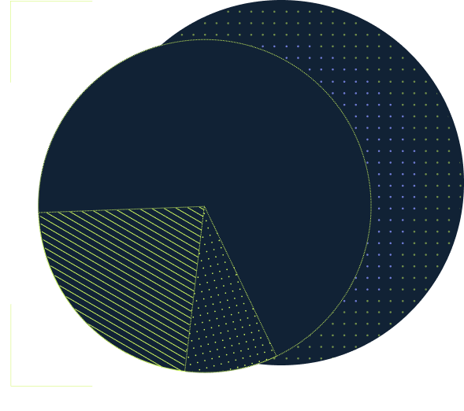
Validating your ICP
Creating an ICP does not guarantee that you’ve accurately identified your ideal client unless you validate your findings. As a CMO, you need to track marketing and sales KPIs, presales and closed-won metrics to verify that your ICP is on track.
Use these metrics to track whether or not you’re targeting the right leads and whether your message is resonating with prospects.

Slide 16
Pre deal close KPIs
KPI | Expected outcome | Actual outcome
Marketing qualified lead (MQL) | Increase in qualified leads from your email marketing, paid advertising and organic lead gen efforts.
Cold outreach responses | Your ICP is on target if you experience an increase in positive responses from cold pitches.
Conversion rates | From demos booked to product sales, the % of leads that take intended actions should increase.
Bounce rates | Based on insights from your ICP, visitors from targeted campaigns should spend a healthy amount of time on your site.
Length in pipeline | With the right ICP, qualified leads should spend the industry average time — or shorter time — in your pipeline.
Our B2B SaaS services: SEO Audits | Enterprise SEO Programs | Web Builds | Web Support | We work with: Tech Startups | CMOs | Demand Gen Leaders

Slide 17
Closed-won KPIs
KPI | Description | Outcome
Customer acquisition costs (CAC) | With an accurate ICP, you should see a lower CAC as you target the customers most likely to convert
Customer lifetime value (CLV) | If your ICP is correct, your average CLV should increase as you attract customers who are a good fit for your business and are likely to stay with you for a longer period.
Customer feedback | For an accurate ICP, feedback from new customers should match the characteristics and behaviors identified in your profile.
Influencers in closed-won deal | The major influencers in the successful deal should hold positions identified in your ICP.
Our B2B SaaS services: SEO Audits | Enterprise SEO Programs | Web Builds | Web Support | We work with: Tech Startups | CMOs | Demand Gen Leaders

Slide 18
Refining your ICP
An ICP is only useful if it provides you with clarity. Continuously refine your ICP with relevant attributes and update your customer personas at least twice a year as you gather more data. Updating the ICP is crucial as customer behavior and preferences change over time. Monitor customer feedback, social media interactions and website analytics to align your marketing sales and demand gen efforts with customer needs.
If you make major changes to your ICP, remember to update your organic and paid campaigns, playbooks and messaging across all platforms to align with your new target market.
The Head of Product Marketing should keep the ICP updated and document changes at least every 6 months.
Our B2B SaaS services: SEO Audits | Enterprise SEO Programs | Web Builds | Web Support | We work with: Tech Startups | CMOs | Demand Gen Leaders

Slide 19
Applying your ICP
What should you do with your ICP?
Finding prospects. Using your ICP, you can identify the characteristics that your most profitable customers share and focus your sales efforts on the most promising leads.
Adjusting your pricing. An ICP can also inform your pricing strategy by identifying the features and benefits that your ideal customers value most.
Forming partnerships. Using your ICP, you can identify potential partnership opportunities with other companies that share a similar target audience but are not direct competitors and develop mutually beneficial relationships with other businesses.
Shaping your messaging across all platforms. Your ICP can inform your messaging strategy by guiding the language, tone and style of your website, social media, email campaigns and advertisements.
💡 Our CMO community requested this complementary Power Point after reading a popular article we released on ICP. Read the post here: https://productiveshop.com/ideal-customer-profile/

Slide 20
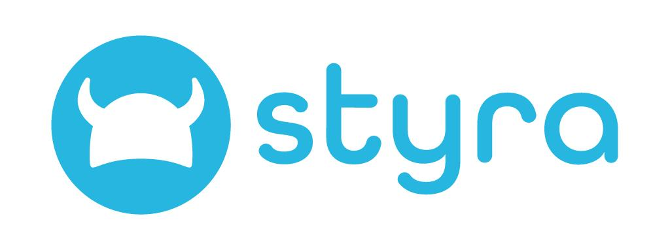
Align your B2B presence with your ICP
Adjusting your online presence to match your ICP doesn’t have to be challenging. Want to upgrade your website, SEO keywords and paid ads to match your current ICP? Productive Shop can help.
See case studies
Our B2B SaaS services: SEO Audits | Enterprise SEO Programs | Web Builds | Web Support | We work with: Tech Startups | CMOs | Demand Gen Leaders

